Slide 1

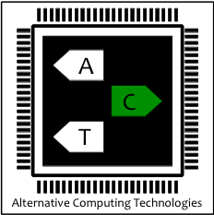
FLEXJAVA: Language Support for Safe and Modular Approximate Programming
Jongse Park, Hadi Esmaeilzadeh, Xin Zhang, Mayur Naik, William Harris
Alternative Computing Technologies (ACT) Lab
Georgia Institute of Technology
ESEC/FSE 2015
Notes:
FLEXJAVA
ACT LAB -> APPROXIMATE COMPUTING
INTRODUCE APPROXIMATE COMPUTING
Hello everyone, this is Jongse Park, a third-year PhD student from Gerogia Tech.
Today, I would like to introduce our work, FlexJava, a programming language for approximate computing.
I am working in ACT lab, alternative computing technologies lab and our main interest is on computer architecture and systems, especially one of the new computing paradigms, so-called “approximate computing”.
So before I jump into a language design of FlexJava, I would like to briefly introduce what approximate computing is and why we need this programming language abstraction for approximate computing.

Slide 2

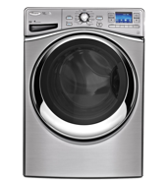
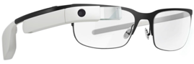
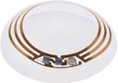
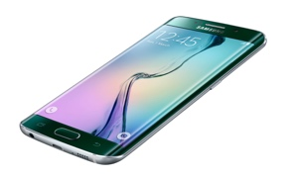
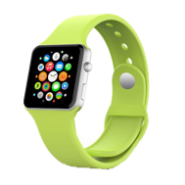
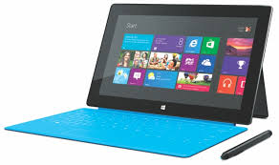
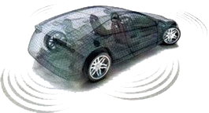
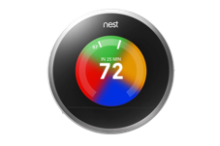
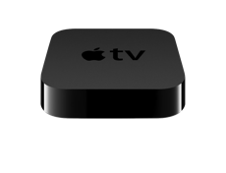
Energy is a primary constraint
Data Center
Mobile
Internet of Things
Notes:
D/C
Mobile
IoT
Claim that
Data center produces and processes a huge amount of data every second, which requires a lot of energy.
When we go to mobile devices, the energy is more constraint and even for IoT devices, energy is even more important resource.
Therefore, I claim that energy is one of the most important aspects of computing these days.

Slide 3
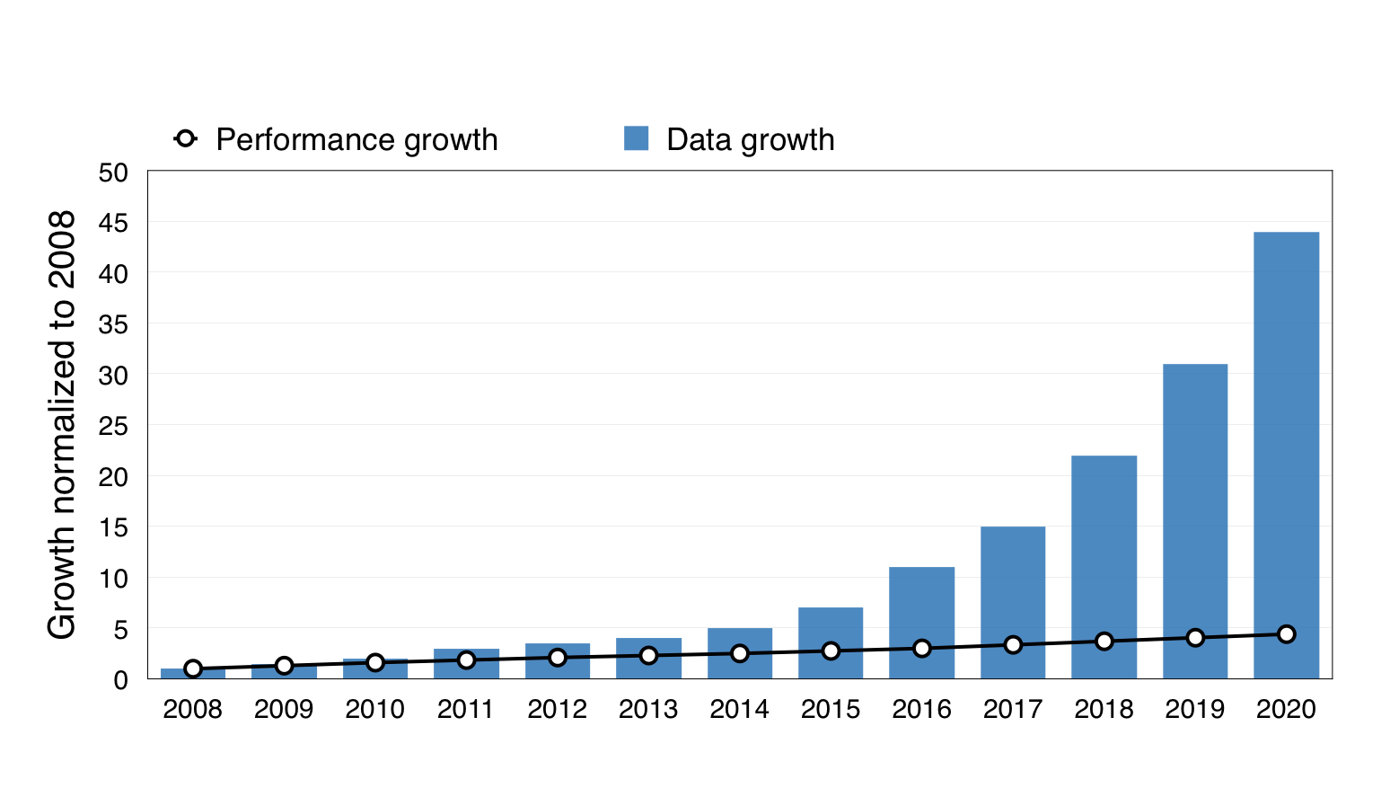
Data growth vs performance
Data growth trends: IDC's Digital Universe Study, December 2012
Performance growth trends: Esmaeilzadeh et al, “Dark Silicon and the End of Multicore Scaling,” ISCA 2011
Notes:
What are the numbers?
LET’S TALK ABOUT DATA AND PERF GROWTH
GAP
INCREASE
YOU MIGHT
WITHOUT
A/C IS
The gap between data and performance growth is becoming bigger and bigger.
The figure shows the expected data and performance growth from 2008 to 2020, which is normalized to those in 2008.
When the performance of a processor improves up to at most 5x in 2020, the data is expected to grow up to 45x, which is huge because of the prevalence of mobile devices.
You might have expected this phenomenon from your experience that the number of devices per each of you has increased and the data size of each device has also increased but you haven’t seen a significant improvement in processor since more than 5 years ago!
Without filling this gap, the potential innovation and new technologies with this giant amount of data will be bounded by the computing capabilities.
Approximate computing is one possible solution to fill this gap.

Slide 4
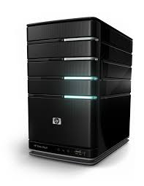
Adding a third dimension Embracing Error
Data center
Desktop
Mobile
IoT
Error
Notes:
CONVENTIONALLY
WHAT WE DO
BY COMPROMISING THE PRECISION
Conventionally, we have a performance-energy tradeoff like this and we can navigate this line to place our hardware.
What we do in approximate computing is to add the third dimension to this tradeoff and shift the points in the line toward the new dimension.
By compromising the precision, we are able to achieve both higher performance and lower energy at the same time.

Slide 5
Navigating a three dimensional space
Data center
Desktop
Mobile
IoT
Error
Notes:
NAVIGATE 3 DIMENSIONAL SPACE
100% ERROR JOKE
So now, we are navigating three dimensional space to find a point for computing.
You can imagine an extreme case that the error is 100% and the system is just giving random outputs.
In this case, we will have infinite speedup and near zero energy dissipation.
However, for now, I am not aiming that high ☺!

Slide 6
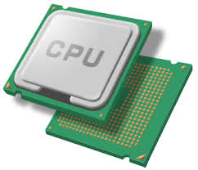
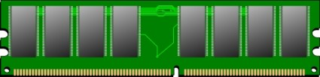

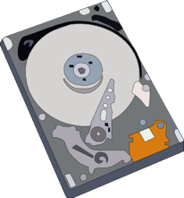
Approximate computing Embracing error
Relax the abstraction of “near perfect” accuracy in
Processing
Storage
Communication
Allows errors to happen to improve
performance
resource utilization efficiency
Notes:
A/C RELAX IN CMP, STO, COM
REASON WHY NEAR…
COMPROMISE
So approximate computing relaxes the abstraction of “near-perfect” accuracy.
The reason why I say “near-perfect” is that we already have imprecision in floating-point computation.
We compromise precision and allow errors to achieve both higher performance and efficiency.

Slide 7

New landscape of computing Personalized and targeted computing
Notes:
POSSIBLE B/C AIMING EACH IND CAN USES, HAVING ERROR
This is possible because we are aiming personalized and targeted computing.
If each individual uses a computing platform for a certain type of application, having imprecision in a controlled manner would be acceptable.

Slide 8
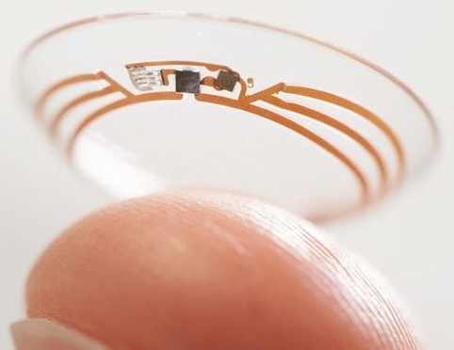
Mobile Computing
IoT Computing
Cloud Computing
Notes:
A SMALL DEGRADATION AS LONG AS
FOR IOT COMPUTING, LETS SAY
For example, I personally wouldn’t mind even if I have a little bit degraded picture of my friend from my Instagram as long as it is good enough.
For IoT computing, let’s say I have a smart contact lens supporting face recognition and I am running out of the batteries, then I wouldn’t mind that it sometimes can’t recognize the faces if this helps me save the energy.
Lastly, let’s say suddenly I really want to see my advisor Hadi’s face and search on Bing. Then I wouldn’t mind the order of pictures as long as I can find him somewhere in the page.

Slide 9
Classes of approximate applications
Programs with analog inputs
Sensors, scene reconstruction
Programs with analog outputs
Multimedia
Programs with multiple possible answers
Web search, machine learning
Convergent programs
Gradient descent, big data analytics
Notes:
WE CAN CATEGORIZE … INTO FOUR CLASSES
ANALOG -> IMAGE, AUDIO, VIDEO
SEARCH ENGINE
AS LONG AS IT CONVERGES TO AN ANSWER
I think we can categorize the applications which are suitable for approximate computing into four classes.
Programs with analog inputs and outputs such as image, audio, or video processing and programs with multiple possible answers like search engine and at last, convergent programs such as big data analytics.
As long as the convergent programs will converge to an answer we are looking for, we would be able to accept some errors during computation.

Slide 10
Avoiding overkill design Approximate Computing
Application
Programming Language
Efficiency
Performance
Compiler
Architecutre
Microarchitecture
Circuit
Cost
Cost
Physical Device
Precision
Reliability
Notes:
WHAT WE WANT TO DO IS
HIGH COST ON … TO GUARANTEE
EXISTS EVERY LAYER FROM… TO…
What we want to do in approximate computing is to avoid overkill design.
All the computing platforms have high cost on resource efficiency and performance to guarantee the precision and reliability.
This cost exists in every layer in computing stack from software to physical devices.

Slide 11

Cross-stack approach
Application
Programming Language
Compiler
Architecutre
Microarchitecture
Circuit
Physical Device
Notes:
WE NEED … BUT THIS IMPOSES…
PROG LAN ABSTR THAT ABSTR AWAY … BUT STILL ENABLE
Therefore what approximate computing does is to have a cross-stack approach.
It means that each approximate computing technique should have a vertical solution throughout all computing layers.
But approximate programming language hide all the layers below compiler and gives a programming language abstraction for programmers to easily use the approximation techniques under the abstraction.

Slide 12
WH² of Approximation
Language
What to approximate?
How much to approximate?
How to approximate?
Compiler
Runtime
Hardware
Notes:
THREE
FIRST TWO, PROGR SHOULD KNOW B/C…
LAST ONE, A/C TECHNIQUE PROVIDES
FJ ALLOWS EXPRESS FIRST TWO
Then what do we need to know for using approximate computing?
The three questions should be answered for it.
What are you going to approximate, how much are you going to approximate, and how you are going to approximate.
Among these three, the first two of them are something that programmers should know because they are the only ones who know the semantics of the program.
But the third one, how to approximate, is something that the designer of approximation technique should provide.
FlexJava allows programmers to express the first two.

Slide 13

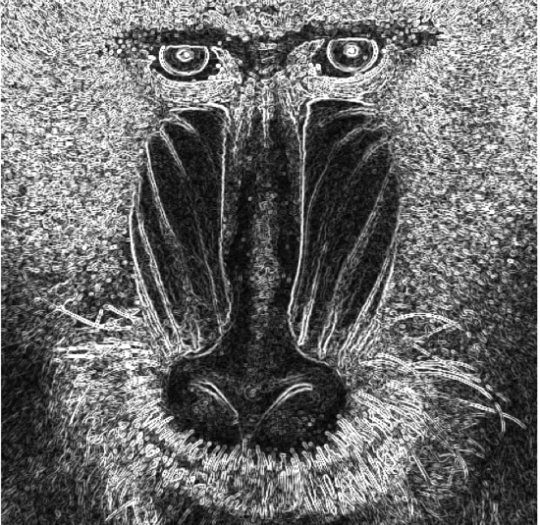
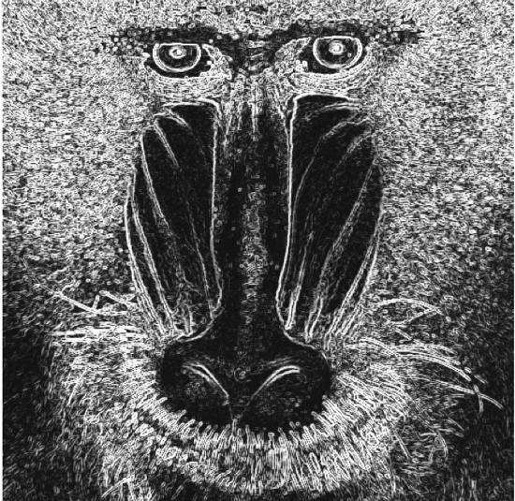

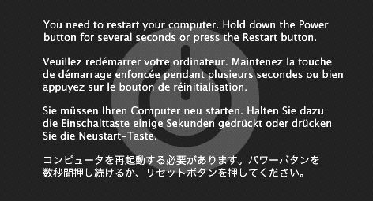
√
√
✗
✗
Notes:
SAFETY
EDGE DETECTION
TOP TWO
ONE PRECISE ONE APPROXIMATE
BOTTOM TWO
HEADER UNSAFE MEMORY LOC
NOTION OF SAFETY
Let’s talk about the notion of safety in approximate computing.
One of the top two images is computed by a normal processor and the other one is approximately computed by an approximation technique.
Approximation only happened when the program was computing the pixel values.
But the two images at the bottom are the images that we would have if the approximation is applied in a wrong way and touched the images’ header and a wrong memory location.
Thus, the approximate programming language should have a full control over what to approximate and provides the safety.

Slide 14

Approximate program
Notes:
KNITTED FABRIC
INTERMIX
We can think an approximate program looks like this knitted fabric.
The region we guarantee the precise computation and another region that we can apply approximation are intermixed.

Slide 15


Separation
Notes:
SEPARATION
So safe and unsafe region of programs in terms of approximation should be separated and the approximate programming language should support the separation.

Slide 16
Goal
Design an automated and high-level programming language for approximate computing
Criteria
Safety
Scalability
Modularity and reusability
Generality
Notes:
GOAL
SAFE
SCALABLE
(1)(2) are the main goal and (3)(4) are additional features
Programmers’ effort is minimized and as a result, the language can be scaled to large programs
Our goal is to design an automated and high-level programming language for approximate computing.
There are mainly four criteria to realize this goal.
The first one is definitely the safety.
We also need to support modular and reusable programming so that the approximate programming language can easily coordinate with modern programming languages.
And the languages should have generality for arbitrary approximate computing technologies and finally the approximate programming should be scalable.

Slide 17
FLEXJAVA
Lightweight set of language extensions
Reducing annotating effort
Language-compiler co-design
Safety
Generality
Scalability
Modularity and reusability
Notes:
INTRO
FOUR CHARACTERISTICS
REDUCING ANNOTATION EFFORT WHILE ENSURING SAFETY
We introduce FlexJava, a lightweight set of language extensions that effectively reduce programmers’ annotation effort.
For that, we propose a language-compiler co-design that provides the previously mentioned four characteristics.
The main difference between FlexJava and previous research in approximate programming language is that we provide the three at the bottom while guaranteeing the safety.

Slide 18
FLEXJAVA Annotations
1. Approximation for individual data and operations
loosen (variable)
loosen_invasive (variable)
tighten (variable)
2. Approximation for a code block
begin_loose (“TECHNIQUE”, ARGUMENTS)
end_loose (ARGUMENTS)
3. Expressing the quality requirement
loosen (variable, QUALITY_REQUIREMENT);
loosen_invasive (variable, QUALITY_REQUIREMENT);
end_loose (ARGUMENTS, QUALITY_REQUIREMENT);
Notes:
FINE
SKIP TIGHTEN
COARSE
EXPRESSING QUAL
SKIP EXPRESSING QUAL
FINE-GRAINED AND COARSE-GRAINED
Let me introduce FlexJava annotations.
First three annotations, loosen, loosen_invasive, and tighten are used for approximation of individual data and operations, which we call fine-grained approximation while the next two annotations, begin_loose and end_loose annotations, are used for approximation of a code block, which we call coarse-grained approximation.
To provide expressibility of the quality, programmers can define a class that describes the quality requirement and pass its instance as the last argument of the loosen, loosen_invasive, and end_loose annotations.
In this talk, I’ll focus on loosen and loosen_invasive annotations for fine-grained approximation and the annotations for coarse-grained approximation.
The paper has a detailed description for the rest of the annotations.

Slide 19
Safe and scalable approximation
float computeLuminance (float r, float g,
float b) {
float luminance = r * 0.3f + g * 0.6f + b * 0.1f;
loosen (luminance);
return luminance;
}
Notes:
LOOSEN
FUNCTION

Slide 20
Safe and scalable approximation
float computeLuminance (float r, float g,
float b) {
float luminance = r * 0.3f + g * 0.6f + b * 0.1f;
loosen (luminance);
return luminance;
}

Slide 21
Safe and scalable approximation
float computeLuminance (float r, float g,
float b) {
float luminance = r * 0.3f + g * 0.6f + b * 0.1f;
loosen (luminance);
return luminance;
}

Slide 22
Safe and scalable approximation
float computeLuminance (float r, float g,
float b) {
float luminance = r * 0.3f + g * 0.6f + b * 0.1f;
loosen (luminance);
return luminance;
}

Slide 23
Safe and scalable approximation
int fibonacci (int n) {
int r;
if (n <= 1)
r = n;
else
r = fibonacci (n – 1) + fibonacci (n – 2);
loosen (r);
return r;
}
Notes:
CONTROL FLOW
FIBONACCI
TALK ABOUT FUNC LATER
FOCUS ON CONDITIONAL
Let me give another example how FlexJava provides safety.
This example is a recursive fibonacci function and programmer annotated r as approximate.

Slide 24
Safe and scalable approximation
int fibonacci (int n) {
int r;
if (n <= 1)
r = n;
else
r = fibonacci (n – 1) + fibonacci (n – 2);
loosen (r);
return r;
}
Notes:
Let me give another example how FlexJava provides safety.
This example is a recursive fibonacci function and programmer annotated r as approximate.

Slide 25
Modularity
int p = 1;
for (int i = 0; i < a.length; i++) {
p *= a[i];
}
for (int i = 0; i < b.length; i++) {
p += b[i];
loosen(p);
}
Notes:
SCOPE
EXAMPLE
To provide modularity in programming, we define a scope of the annotation as the code block where the annotation is placed.
The approximation is restricted within the scope and doesn’t go beyond the scope.
In this way, programmers can intuitively understand what would be the effect of the annotation.
In the example, this loosen annotation is in the second for loop so it doesn’t impact on the data and operations in the first loop.

Slide 26
Reuse and library support
static int square(int a) {
int s = a * a;
loosen(s);
return s;
}
main () {
int x = 2 * square(3);
System.out.println(x);
}
Notes:
BUILDING FROM SCRACH INFEASIBLE
ENABLE REUSE AND SUPPORT A/C LIB
TWO SEMANTICS
LOOSEN IS DEFAULT
In general, building the whole software from scratch is infeasible in modern software engineering.
To enable reusing approximate programs and support approximate library, we have two semantics in terms of function call.
The loosen that I have been introducing is the default case.
Let’s say square function is a library function and the library programmer put the loosen annotation for s.
By default, in this case, nothing is safe-to-approximate because application programmer who wrote main function didn’t explicitly enable this annotation.

Slide 27
Reuse and library support
static int square(int a) {
int s = a * a;
loosen(s);
return s;
}
main () {
int x = 2 * square(3);
loosen(x);
System.out.println(x);
}
Notes:
In general, building the whole software from scratch is infeasible in modern software engineering.
To enable reusing approximate programs and support approximate library, we have two semantics in terms of function call.
The loosen that I have been introducing is the default case.
Let’s say square function is a library function and the library programmer put the loosen annotation for s.
By default, in this case, nothing is safe-to-approximate because application programmer who wrote main function didn’t explicitly enable this annotation.

Slide 28
Reuse and library support
static int square(int a) {
int s = a * a;
loosen(s);
return s;
}
main () {
int x = 2 * square(3);
loosen(x);
System.out.println(x);
}
Notes:
In general, building the whole software from scratch is infeasible in modern software engineering.
To enable reusing approximate programs and support approximate library, we have two semantics in terms of function call.
The loosen that I have been introducing is the default case.
Let’s say square function is a library function and the library programmer put the loosen annotation for s.
By default, in this case, nothing is safe-to-approximate because application programmer who wrote main function didn’t explicitly enable this annotation.

Slide 29
Reuse and library support
static int square(int a) {
int s = a * a;
loosen(s);
return s;
}
main () {
int x = 2 * square(3);
loosen(x);
System.out.println(x);
}
Notes:
In general, building the whole software from scratch is infeasible in modern software engineering.
To enable reusing approximate programs and support approximate library, we have two semantics in terms of function call.
The loosen that I have been introducing is the default case.
Let’s say square function is a library function and the library programmer put the loosen annotation for s.
By default, in this case, nothing is safe-to-approximate because application programmer who wrote main function didn’t explicitly enable this annotation.

Slide 30
Reuse and library support
static int square(int a) {
int s = a * a;
return s;
}
main () {
int x = 2 * square(3);
loosen(x);
System.out.println(x);
}
Notes:
BUILDING FROM SCRACH INFEASIBLE
ENABLE REUSE AND SUPPORT A/C LIB
TWO SEMANTICS
LOOSEN IS DEFAULT
In general, building the whole software from scratch is infeasible in modern software engineering.
To enable reusing approximate programs and support approximate library, we have two semantics in terms of function call.
The loosen that I have been introducing is the default case.
Let’s say square function is a library function and the library programmer put the loosen annotation for s.
By default, in this case, nothing is safe-to-approximate because application programmer who wrote main function didn’t explicitly enable this annotation.

Slide 31
Reuse and library support
static int square(int a) {
int s = a * a;
return s;
}
main () {
int x = 2 * square(3);
loosen(x);
System.out.println(x);
}
Notes:
BUILDING FROM SCRACH INFEASIBLE
ENABLE REUSE AND SUPPORT A/C LIB
TWO SEMANTICS
LOOSEN IS DEFAULT
In general, building the whole software from scratch is infeasible in modern software engineering.
To enable reusing approximate programs and support approximate library, we have two semantics in terms of function call.
The loosen that I have been introducing is the default case.
Let’s say square function is a library function and the library programmer put the loosen annotation for s.
By default, in this case, nothing is safe-to-approximate because application programmer who wrote main function didn’t explicitly enable this annotation.

Slide 32
Reuse and library support
static int square(int a) {
int s = a * a;
return s;
}
main () {
int x = 2 * square(3);
loosen_invasive(x);
System.out.println(x);
}
Notes:
LOOSEN_INVASIVE
But when some programmers need to use existing libraries and are willing to use approximation in them, it could be burdensome to annotate loosen annotation in every function.
We have loosen_invasive annotation for the programmers who want to approximate everything safe in the entire program even through the function calls.

Slide 33
Reuse and library support
static int square(int a) {
int s = a * a;
return s;
}
main () {
int x = 2 * square(3);
loosen_invasive(x);
System.out.println(x);
}
Notes:
But when some programmers need to use existing libraries and are willing to use approximation in them, it could be burdensome to annotate loosen annotation in every function.
We have loosen_invasive annotation for the programmers who want to approximate everything safe in the entire program even through the function calls.

Slide 34
Reuse and library support
static int square(int a) {
int s = a * a;
return s;
}
main () {
int x = 2 * square(3);
loosen_invasive(x);
System.out.println(x);
}
Notes:
But when some programmers need to use existing libraries and are willing to use approximation in them, it could be burdensome to annotate loosen annotation in every function.
We have loosen_invasive annotation for the programmers who want to approximate everything safe in the entire program even through the function calls.

Slide 35
Reuse and library support
static int square(int a) {
int s = a * a;
return s;
}
main () {
int x = 2 * square(3);
loosen_invasive(x);
System.out.println(x);
}
Notes:
But when some programmers need to use existing libraries and are willing to use approximation in them, it could be burdensome to annotate loosen annotation in every function.
We have loosen_invasive annotation for the programmers who want to approximate everything safe in the entire program even through the function calls.

Slide 36
Reuse and library support
static int square(int a) {
int s = a * a;
return s;
}
main () {
int x = 2 * square(3);
loosen_invasive(x);
System.out.println(x);
}
Notes:
But when some programmers need to use existing libraries and are willing to use approximation in them, it could be burdensome to annotate loosen annotation in every function.
We have loosen_invasive annotation for the programmers who want to approximate everything safe in the entire program even through the function calls.

Slide 37
Generality
Loop perforation and loop early-termination [ESEC/FSE’11, PLDI’10]
Software
Function substitution [PLDI’10]
Truffle: Architecture support for approximate computing [ASPLOS’12]
Hardware
NPU: Neural acceleration [MICRO’12]
Flikker: Saving DRAM refresh power [ASPLOS’11]
Memory
RFVP and load value prediction [PACT’14, MICRO’14]
Notes:
FINE
CODE BLOCK
LOOP BODY OR FUNC
TWO EXAMPLES
Thus far, I have been talking about fine-grained approximation.
But many approximate computing techniques are applied for a code block such as a loop body or a function
Let me give you just two of the examples to show how programmers can enable the approximation techniques.

Slide 38
Generality
begin_loose(“PERFORATION”, 0.10);
for (int i = 0; i < n; i++) {
…
}
end_loose();
Notes:
INTRO PERF
WRAP
FIRST -> PERF
SECOND -> PERF RATE
The begin_loose and end_loose annotation wraps up a code block where an approximation technique will be applied.
The first argument of begin_loose is a string that specifies the technique name, which will be understood by FlexJava compiler and the other arguments are the technique-specific.
Simply put, the loop perforation technique is just to skip some of the loop iterations although it has an intelligent way to decide which iteration to be skipped.
But the detailed technique is hidden and programmers can just specify the perforation rate, which is 0.1 in this particular case.

Slide 39
Generality
begin_loose(“NPU”);
p = Math.sin(x) + Math.cos(y);
q = 2 * Math.sin(x + y);
end_loose();
Notes:
INTRO NPU
NPU
TRAIN INTO A NEURAL MODEL
SUBSTITUTE
OFFLOAD THE COMP TO NPU

Slide 40
Approximation Safety Analysis
Find the maximal set of safe-to-approximate data/operations
For each annotation, loosen(v), find the set of data and operations that affect v
Merge all the sets
Exclude the data and operations that affect control flow
Exclude the data and operations that affect address calculations
The rest of the program data and operations are precise
Notes:
HOW WE FIND SAFE-… IN A SCALABLE
Now I am going to introduce how we find the safe-to-approximate data and operations in a scalable manner.
We use a scalable static dataflow analysis.
For each annotation, the dataflow analysis first finds a set of all data and operations that contribute the annotated variable and merge them into a set
Then remove unsafe-to-approximate data and operations from the set and everything else is precise.

Slide 41

Workflow
Source code
Programming
FLEXJAVA annotations
Approximation Safety Analysis
Compilation
Safe-to-approximate data/operations
Source-code Highlighting Tool
Feedback
Highlighted
Source Code
Notes:
Let’s talk about the workflow.
Programmer first gives his or her source code with FlexJava annotations.
The compiler performs the approximation safety analysis and finds the set of safe-to-approximate data and operations.
Then in the feedback phase, our source-code highlighting tool marks the approximated data and operations on the original source code.
Currently, it is comments at the end of corresponding lines.
So programmers can observe what happened in the analysis and possibly add or remove annotations from the programs.
When the programmer is satisfied, the compiler produces an approximate program.

Slide 42
Benchmark
sor # lines: 36
SciMark2 benchmark
Successive Over-relaxation
sobel # lines: 163
Image processing
Image edge detection
smm # lines: 38
SciMark2 benchmark
Matrix-vector multiplication
raytracer # lines: 174
Graphics
3D image renderer
mc # lines: 59
SciMark2 benchmark
Mathematical approximation
jmeint # lines: 5,962
3D gaming
Triangle intersection kernel
fft # lines: 168
SciMark2 benchmark
Signal processing
hessian # lines: 10,174
Image processing
Interest point detection
lu # lines: 283
SciMark2 benchmark
Matrix factorization
zxing # lines: 26,171
Image processing
Bar code decoder
Notes:
ENERJ
USER-STUDY
Let’s talk about our evaluation.
We used ten benchmarks from a wide range of domains to evaluate its usability.
The size of the benchmarks are diverse from small kernels to large open source code.
We used one of the state-of-the-art approximate programming languages, called EnerJ, as baseline to compare the number of annotations and annotation time.
To measure annotation time, we conducted an user-study and we used the sor, smm, and fft benchmarks for it.

Slide 43
Number of Annotations
Lower is Better
2× to 17× reduction in the number of annotations
Notes:
This figure shows for each benchmark, how many annoations are required for both EnerJ and FlexJava to make the same set of data and operations as approximate.
FlexJava required from 2x to 17x less annotations compared to EnerJ due to the automated approximation safety analysis.
The comparison in the number of annotations shows that FlexJava significantly reduces programmers’ manual effort on individual data and operations

Slide 44
User-study: Annotation Time
Lower is Better
10 subjects (programmers)
Time for annotating fft using EnerJ and FLEXJAVA
8× average reduction in annotation time
Notes:
So we conducted an user-study to have another point of view toward the annotation effort, which is annoting time.
We asked ten subjects to annotate the three programs, sor, smm, and fft using both languages.
I just picked fft among the three we used but the trends are similar.
Compared to EnerJ, FlexJava requires on average 8x less time for annotation and this result even includes the time for using source-code highlighting tool.
These two results show that FlexJava effectively reduced the programming effort

Slide 45
FLEXJAVA
Language-compiler co-design to
Automate approximate programming
Reduce programmer effort
Safety
Generality
Scalability
Modularity and reusability
Notes:
In summary, FlexJava is a language-compiler co-design that automates approximate programming, which reduces the programmer effort while providing the following four features.

Slide 46
Replication Package
http://act-lab.org/artifacts/flexjava/
Annotated benchmarks
Compiler with approximate safety analysis
Source code highlighting tool
Open source git repository: https://bitbucket.org/act-lab/flexjava.code
Notes:
The annotated benchmarks, FlexJava compiler with the analysis, and source code highlighting tool are available at our group homepage and source code is maintained separate in this Bitbucket git repository.

Slide 47
Loop perforation and loop early-termination [ESEC/FSE’11, PLDI’10]
Software
Function substitution [PLDI’10]
Truffle: Architecture support for approximate computing [ASPLOS’12]
Architecture
NPU: Neural acceleration [MICRO’12]
Flikker: Saving DRAM refresh power [ASPLOS’11]
Memory
RFVP and load value prediction [PACT’14, MICRO’14]
Notes:
Let me introduce a few approximation techniques to help you understand.
Although there are many other techniques out there, I am just giving six examples, two for each layer, software, architecture, and memory.
First, in software, loop perforation and loop early termination is to skip some loop iterations or terminate the loop before it iterates all of them.
It may sound simple but it requires a platform that guarantees that the results are not going crazy and get a reasonable output with a bounded quality degradation.
Similar to that, function substitution enables programmers to give several version of functions with different degree of approximation, and it intelligently substitute the function at runtime.
In case of architecture, truffle provides an architecture that supports approximate-mode instructions and its compiler produces that instructions.
NPU is an accelerator that computes a neural network model.
Programmer need to specify a region in programs that they want to offload this part to NPU and NPU compiler trains the region of code into a neural network model and accelerates using the NPU.
In memory, Flikker reduce the DRAM refreshing rate to save energy. Of course, it introduces some error possibly.
RFVP and load value prediction is that when processor need data, instead of going memory, getting the data, and sending to the processor, the processor has a predictor and provides the data from the predictor.
As you might be able to imagine, all these techniques requires programmers’ support because approximation techniques should know that what they can approximate and how much they can approximate.

Slide 48

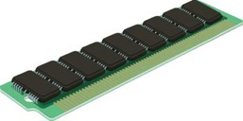
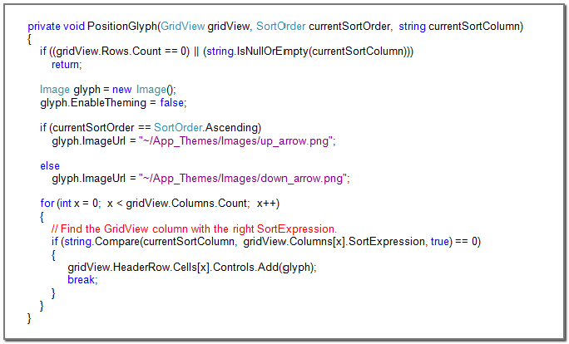
Microarchitecture
Approximate processor [ASPLOS’12]
Accelerator
Neural acceleration (Neural Processing Unit) [MICRO’12]
Memory
DRAM with low refresh rate [ASPLOS’11]
Load value approximation [MICRO’14]
Software
Loop perforation [ESEC/FSE’11]
Function substitution [PLDI’10]
Many others…

Slide 49
Approximate programming:
Language and compiler support
for approximate computing

Slide 50
Safety is the first priority
in approximate programming
language

Slide 51
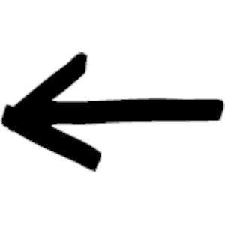
Programmer’s
manual/explicit annotations
[EnerJ PLDI’11, Rely OOPSLA’13]
Automated approximate programming

